Slide 1


Vivekananda College of Engineering & Technology
[A Unit of Vivekananda Vidyavardhaka Sangha Puttur®]
Affiliated to Visvesvaraya Technological University
Approved by AICTE New Delhi & Recognised by Govt of Karnataka
DEPARTMENT OF COMPUTER SCIENCE AND ENGINEERING ( DATA SCIENCE )
Project Phase I Synopsis Presentation on
Web-Based Automatic Timetable Scheduler for Schools & Colleges
Presented by : Gaurav G Alva
4VP22CD019
Harshit M Naik
4VP22CD022
Prapthi J P
4VP22CD037
Supreetha N S
4VP22CD058
Guided by : Prof. Chaithanya D

Slide 2
Problem Identification
Delays in certificate issuance following online events and offline competitions.
Generating and accessing certificates in bulk can be time consuming and unreliable.

Slide 3
Existing solution
Manual certificate printing and handing over to the students at institution level.
Manually typing all the details of the participants and allowing them to download.
Organisation uploads the event certificates in bulk, and participants will have to download it.

Slide 4
Proposed Solution
The organiser generates the certificate using the information provided by participants during the event. The certificates are then sent to each participant’s email address, allowing them to download it easily.
The organiser can upload customised templates of the certificates based on event requirements.
Participant receives the certificate specifically via Gmail.

Slide 5
User requirements
System Requirements:
PC should have at least 4 GB of RAM,
Windows 7 and upwards.
Python version least 3.8 or above.
SQLite default database.
Internet access.
Project Components:
Identifying the requirements of the Certificate generation process.
Details about the events, workshops or conferences.
Customization of templates as per the event requirements.

Slide 6
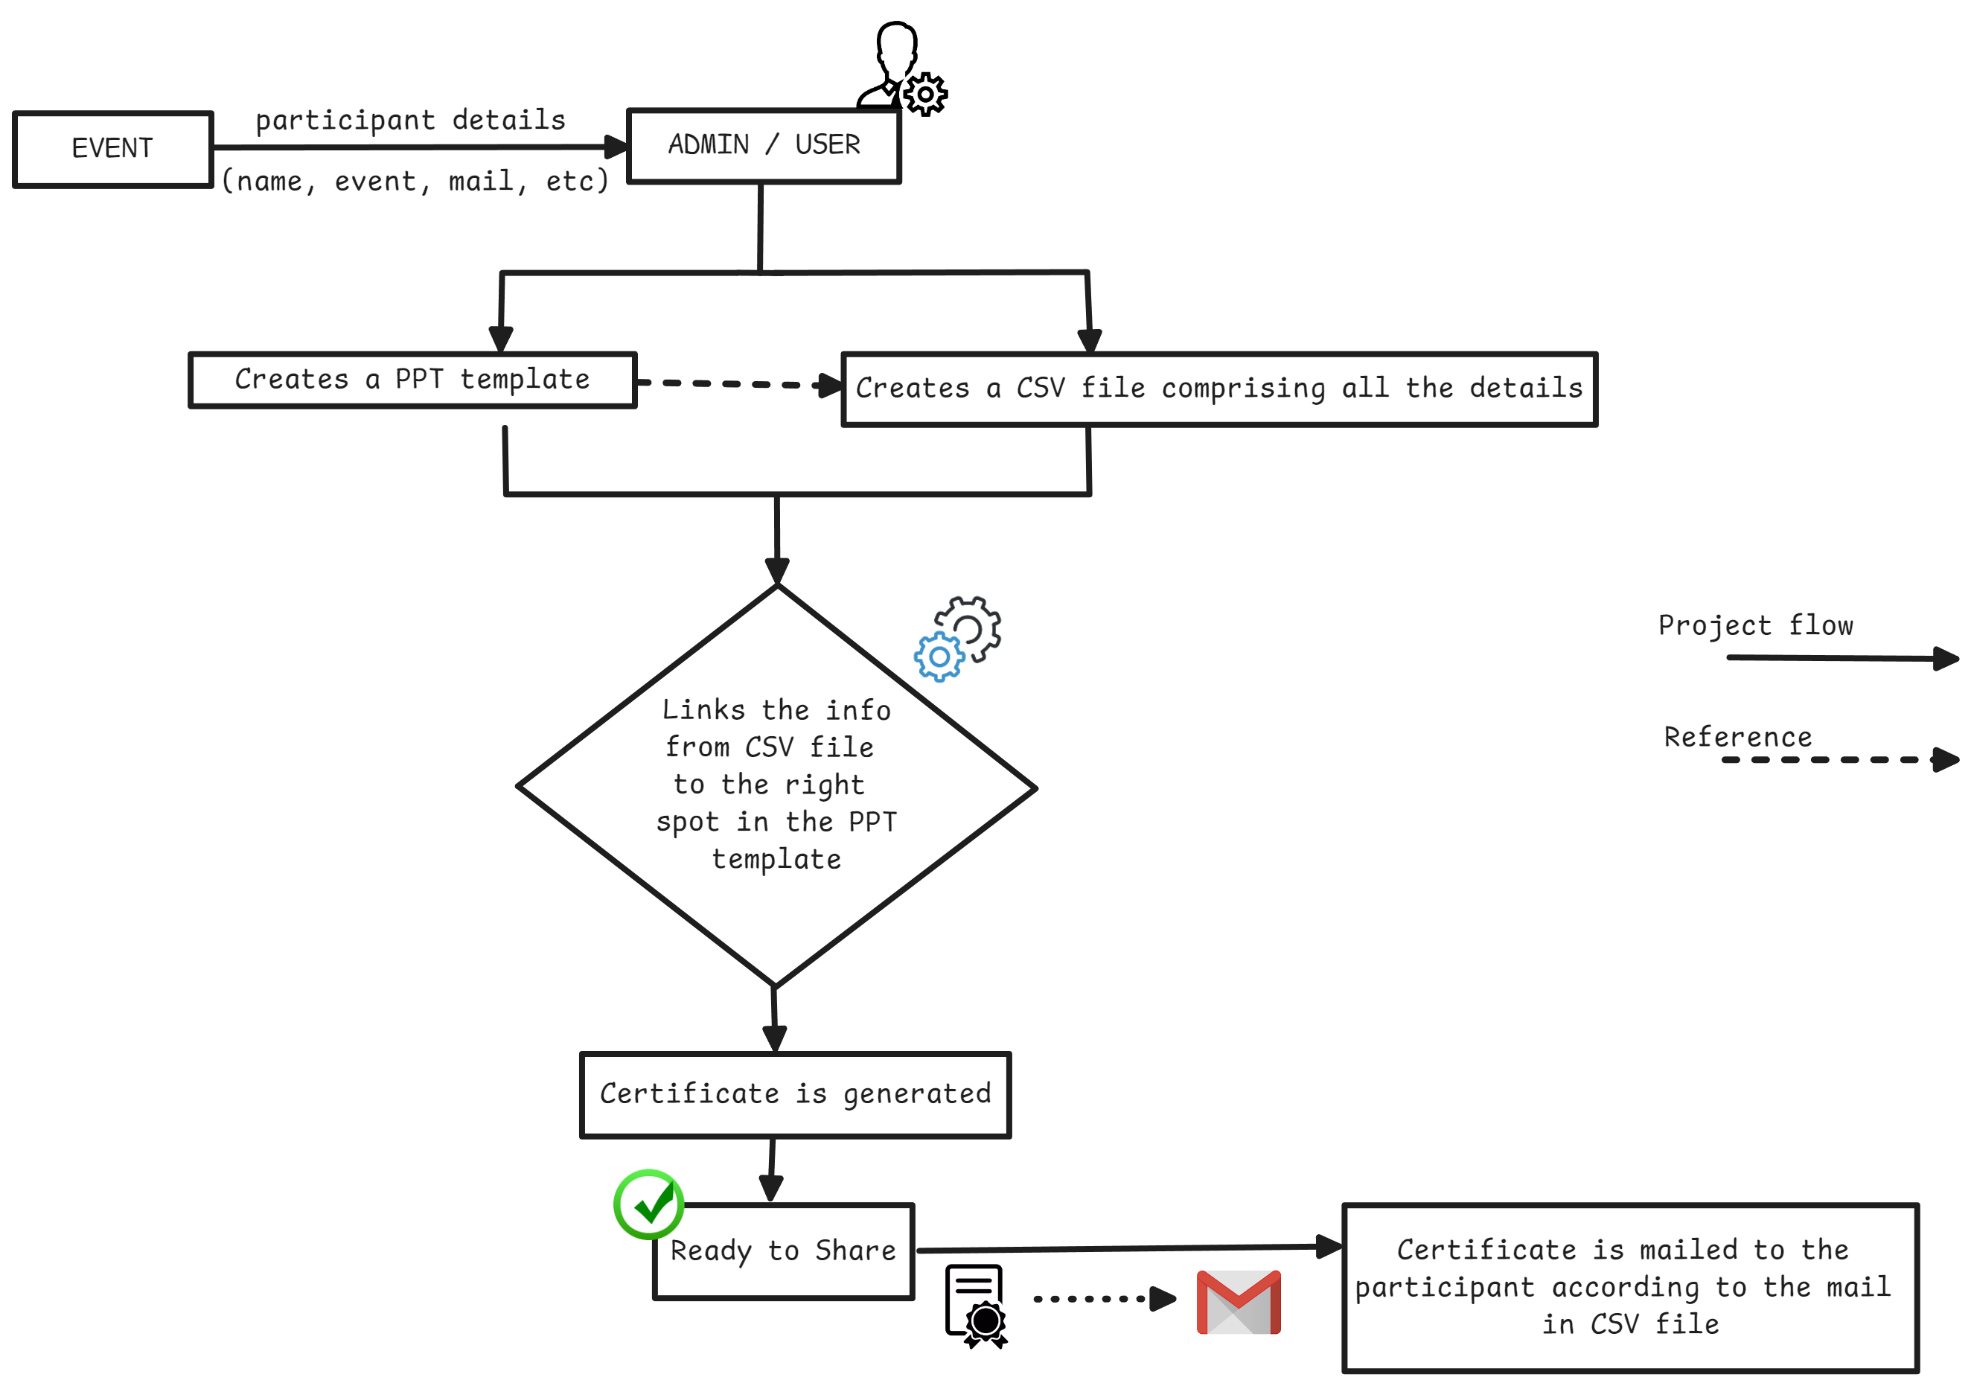
Methodology

Slide 7
Methodology
Design and Development:
User friendly interface for uploading PPT templates and CSV data.
Using basic HTML, CSS and Django and other PyPi libraries for development ( ppt2pdf, pymail, excel2csv, etc ).
Integration of Email for automated distribution(*Google Workspace Account).
Deployment:
Deploying the System in the Server / Cloud platform (AWS or Google Cloud).
GitHub for managing the Code.

Slide 8
Conclusion
An efficient certificate issuance process is essential for participant satisfaction. By allowing organizers to generate certificates using event information and customized templates, thus streamlining the delivery. Sending certificate directly to participant’s Gmail ensures easy access and timely recognition of their achievements.

Slide 9
References
Soham Bandgar, Atharv Patil, Tanmay Mungekar, Prof. Bhanu Tekwani “Online certificate generation and verification system”
(IJRMETS - Volume:04/Issue:02/February-2022)
Rohan Hargude, Ghule Ashutosh, Abhijit Nawale, Prof.Sharad Adsure “Generating E-Certificate and Validation using Blockchain”
(IJCRT - IJCRT2107013)
Ravi Singh Lamkoti, Devdoot Maji, Hitesh Shetty, Prof. Bharati Gondhalekar “Certificate Verification using Blockchain and Generation of Transcript ”
(IJERT - IJERTV10IS030260)

